Slide 1
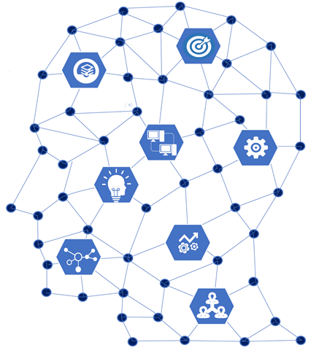
Artificial Intelligence – An Overview

Slide 2
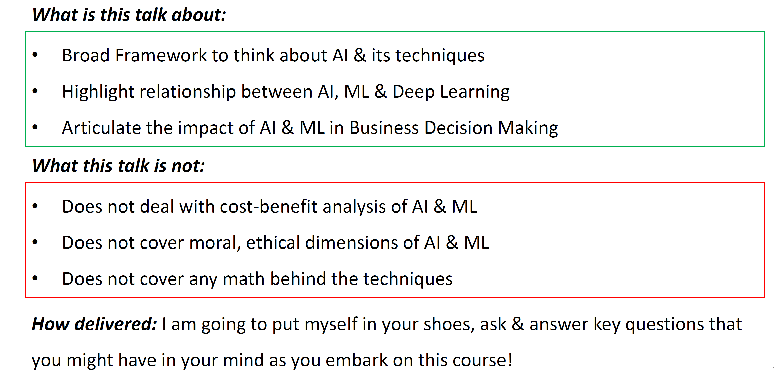
What does this session entails…

Slide 3
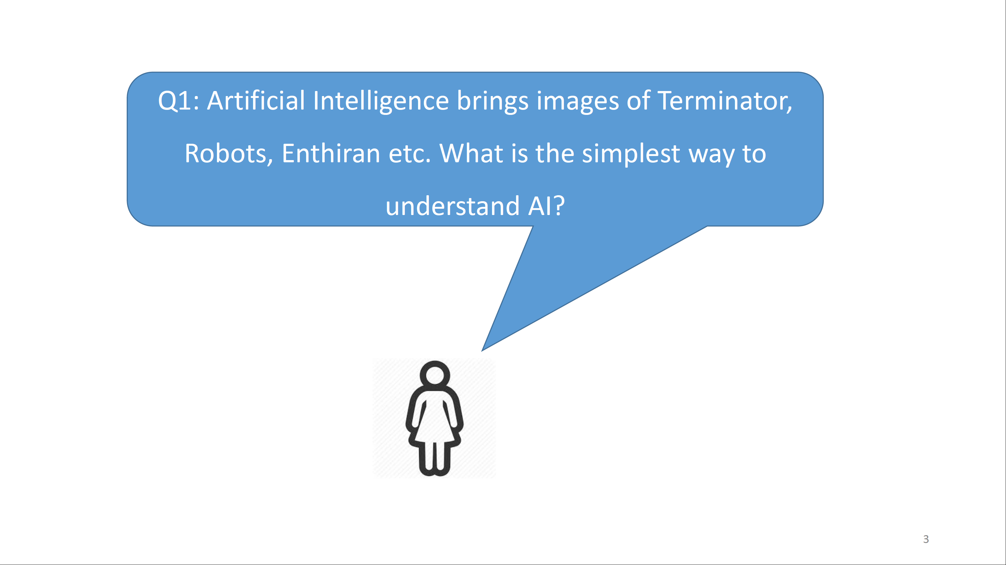
Question 1

Slide 4
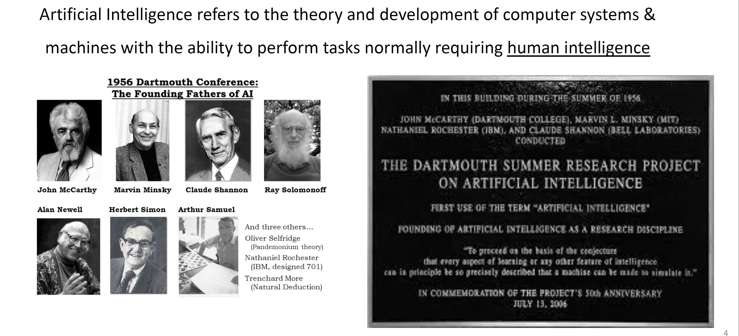
What is Artificial Intelligence?

Slide 5
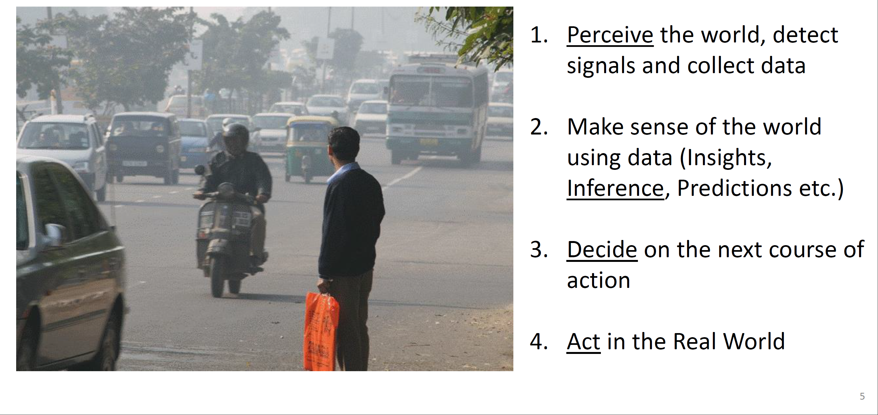
What is Human Intelligence?

Slide 6
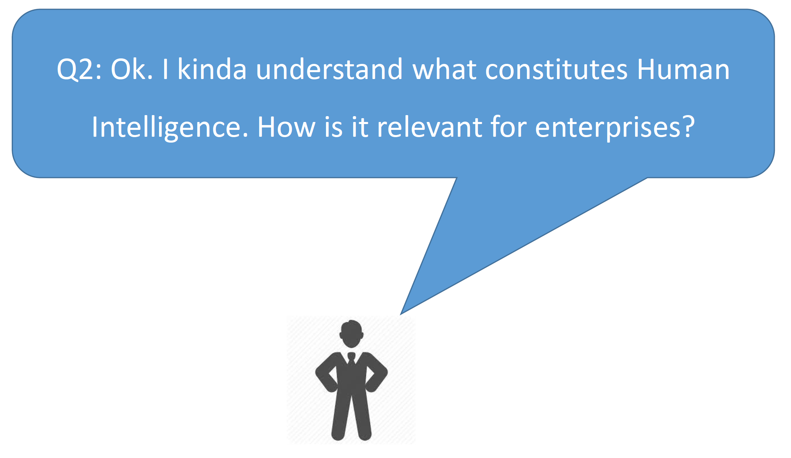
Question 2

Slide 7
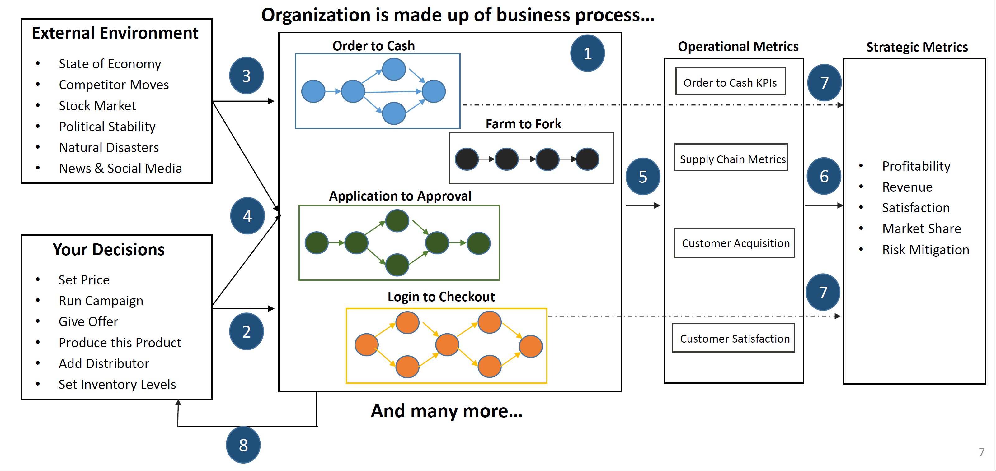
Business Decision Making is Complex and Complicated…

Slide 8
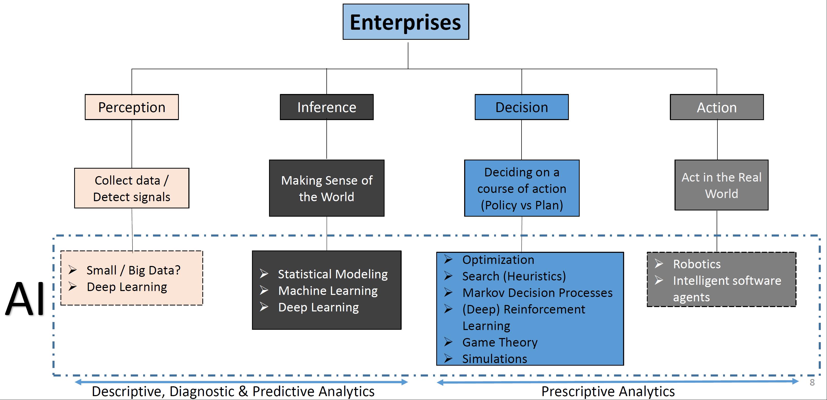
AI Techniques in Organizations parallels to human intelligence…

Slide 9
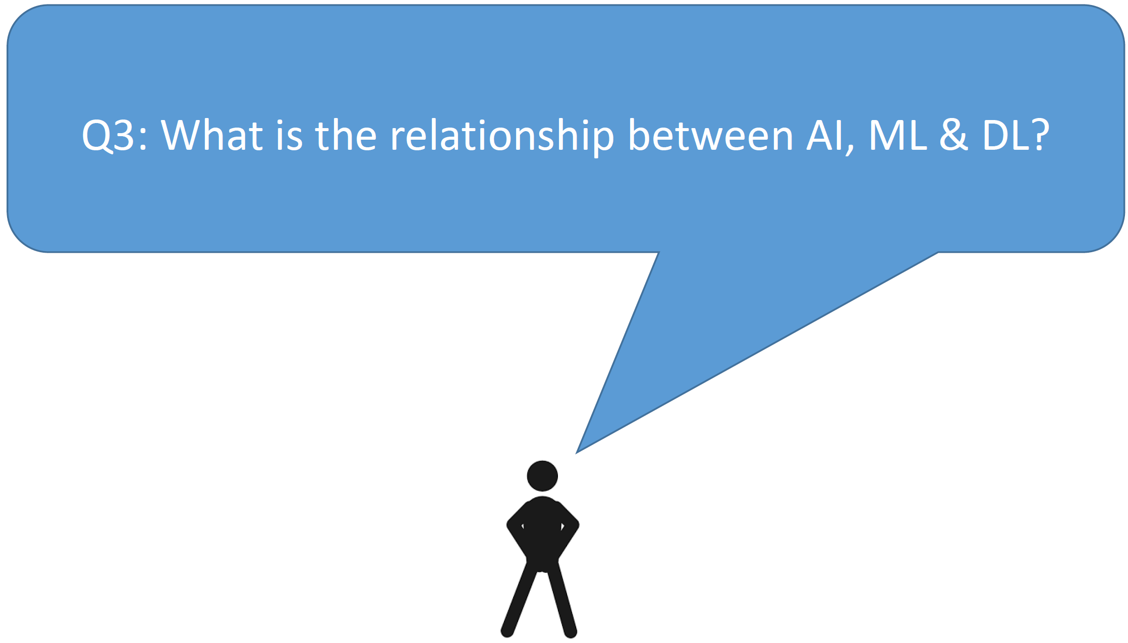
Question 3…

Slide 10
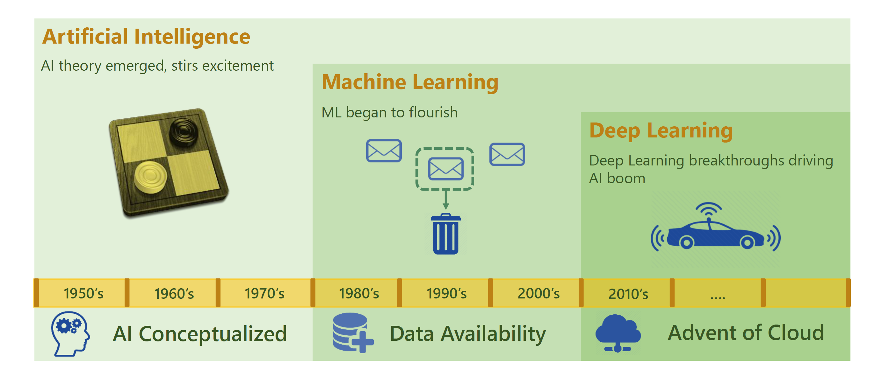
AI in relation to Machine Learning and Deep Learning

Slide 11
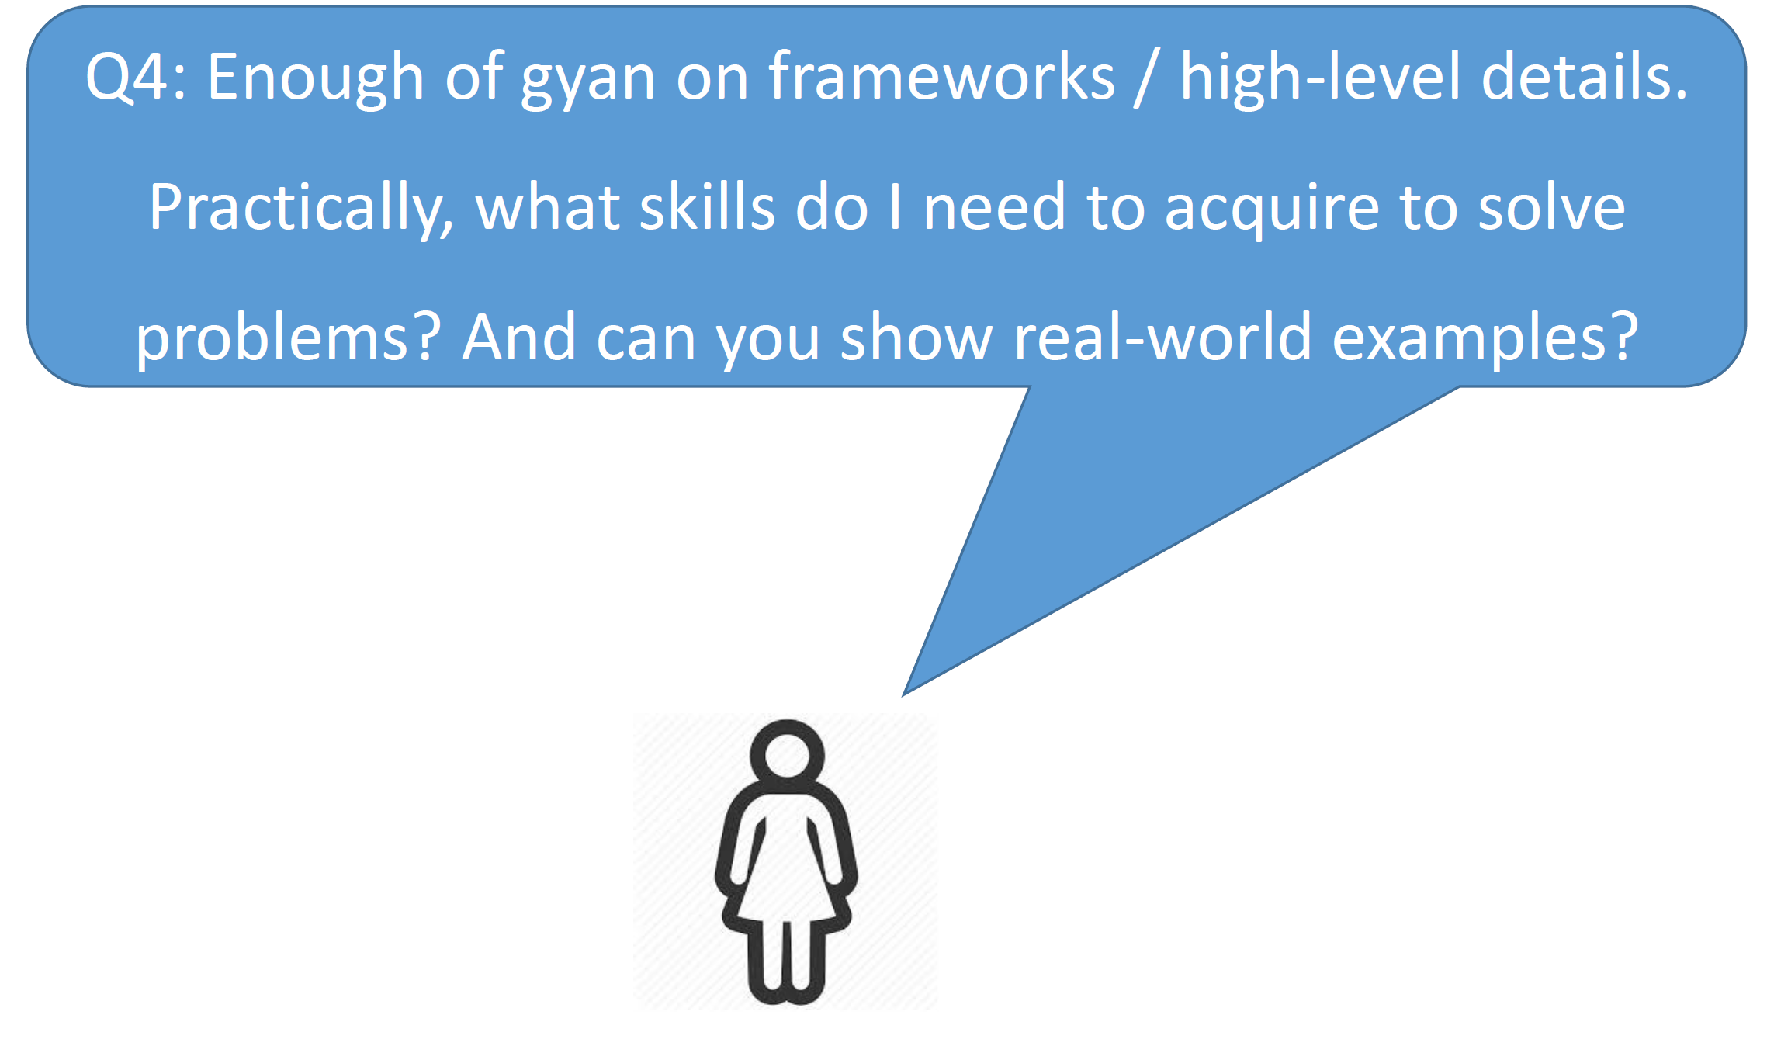
Question 4

Slide 12
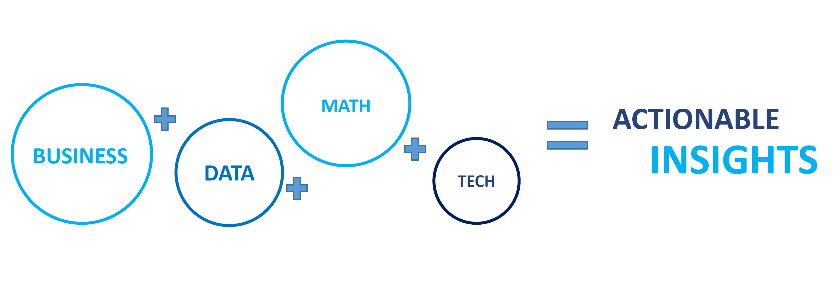
Formula for AI & ML

Slide 13
Case Study 1 :
SR VII Process in SCB GBS

Slide 14
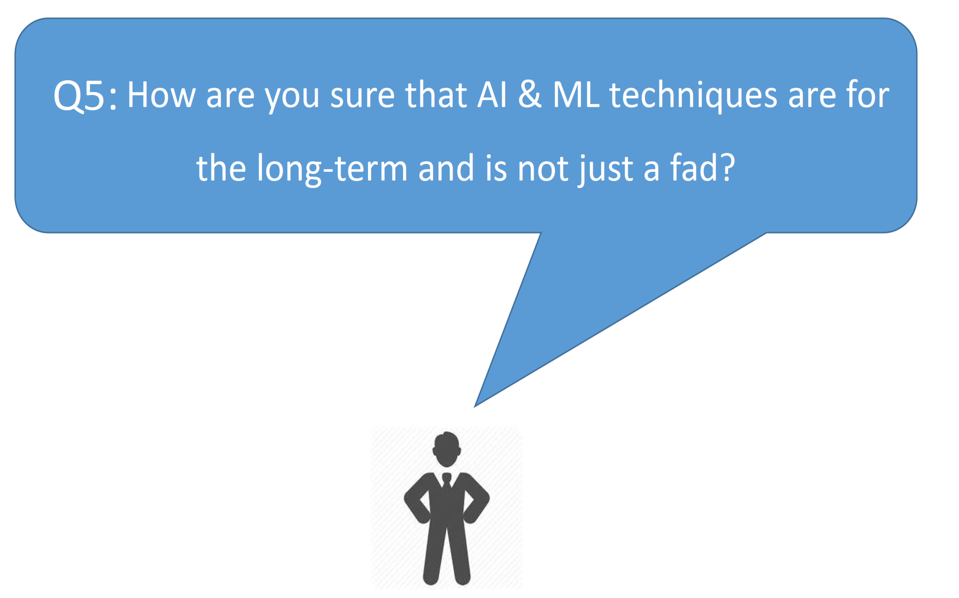
Question 5

Slide 15
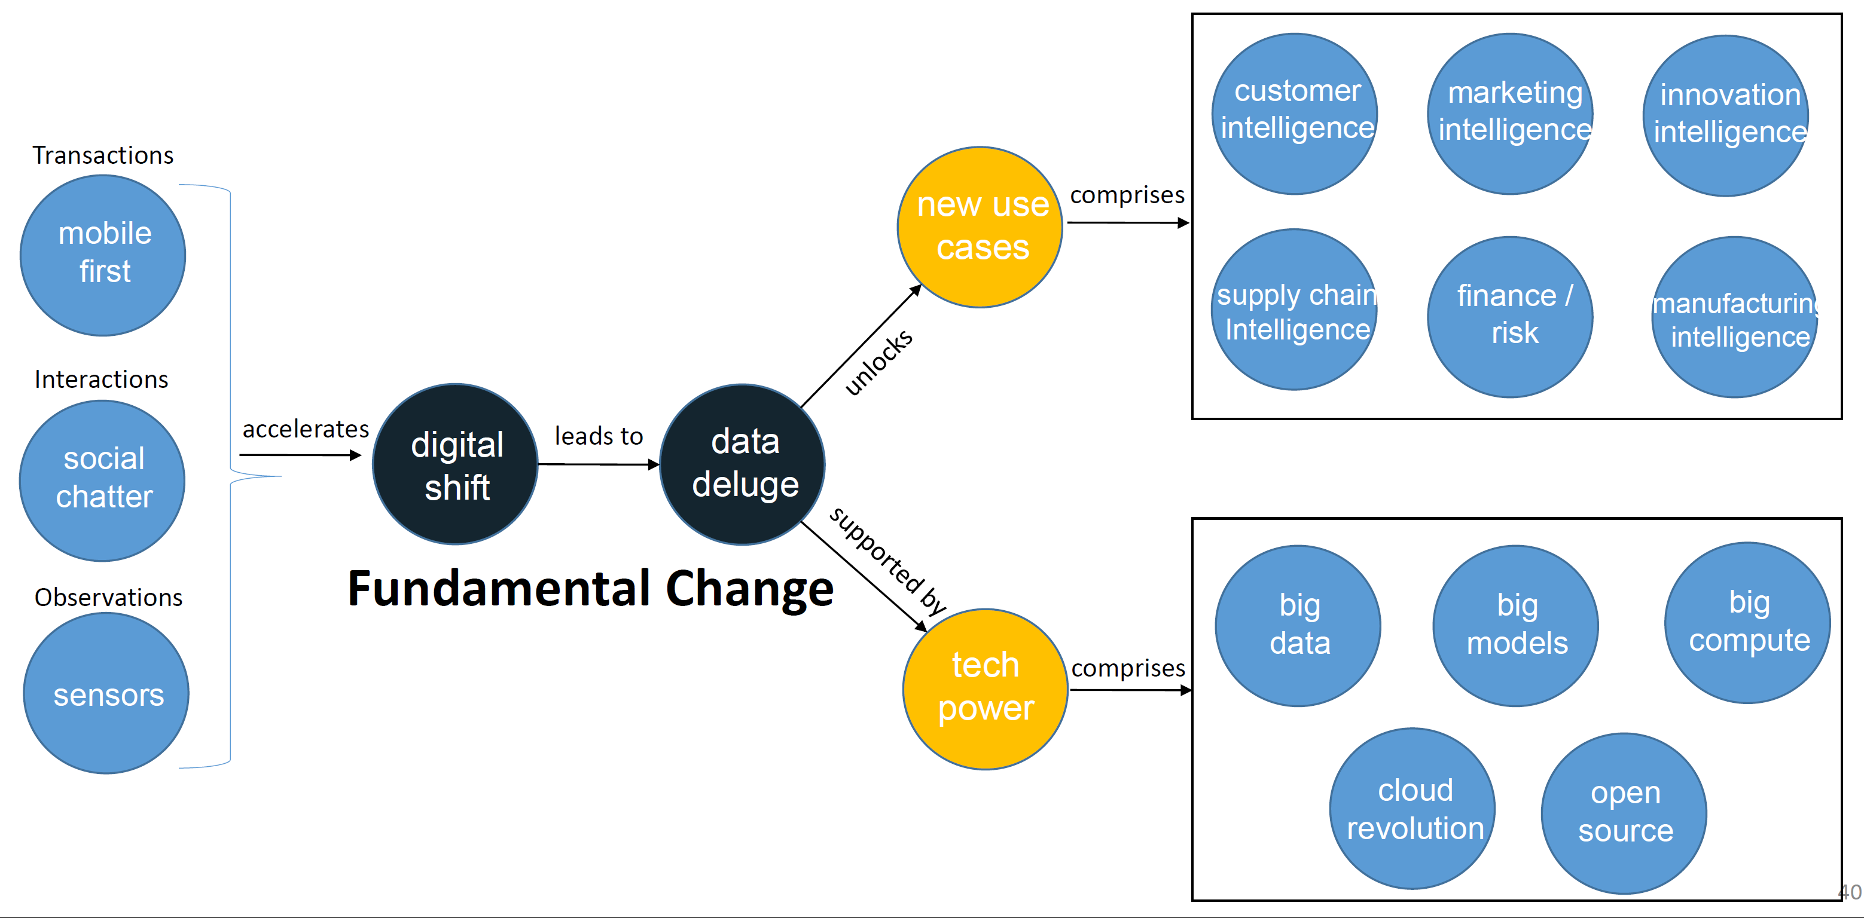
Digital Shift – Fundamental and Irreversible

